Slide 1

Introduction
Problem Definition
At any Property and Casualty insurance carrier, one of the biggest challenges is deciding which insurance products are right for their clients’ needs. According to (Boodhun, N. & Jayabalan, M., 2018), Risk proﬁles of insured's business are analyzed end-to-end by the underwriting team in Property and Casualty insurance business. The role of the underwriter is to ensure that the risks being insured as part of the insured's business are thoroughly reviewed, careful coverage selections are made and premiums are booked accurately ensuring profitability for the insurer.
Risk selection is a common problem among Property and Casualty insurance carriers - It refers to choosing right coverages and exclusion that are appropriate for the insured business and the estimated level of potential risks. The coverage or risk selection can be achieved using predictive analytics, appropriate tools and technologies and historical data that is available.
What is the current state?
The conventional methods of risk selection practiced over years have proven to be time consuming and inefficient.
Risk Selection delays quoting and issuance for insureds and results in lost business due to delay in UW decisions.
Predictive analytics has been used for several years in the claims space to detect severity and probability recovery but there has not been extensive research in this area for coverage or risk selection and product group selection.
What is the objective?
The objective of this research is to employ predictive analytics to determine the correct product group for the risks being covered using historical data and recommend an optimized model that can predict the correct product group for new business requests. The prediction should help the carrier determine the products that should be promoted to secure new business.

Slide 2
Research Question...
Formulation of Research Question
This research is a first step towards determining the right set of coverages or doing risk selection for an insured’s business. The first step is identifying the right Product Group for a client’s business. Every insurance carrier has its own set of Product Groups but the dataset that is used in this research has two Product Groups making it a binomial classification problem.
Target Classes
0-Primary
1-Secondary
So the question is -
“How to predict the Product Group for an insured’s business?”
Past Studies
Property and Casualty insurers over 25 years have been using Predictive Analytics to determine severity of claim, fraud detection and scoring disability claims on probability of recovery but coverage/risk selection determination has been an active research primarily due to underwriting complexities, shortage of data and technology limitations . I have quoted some interesting studies in the “References” slide at the end.

Slide 3
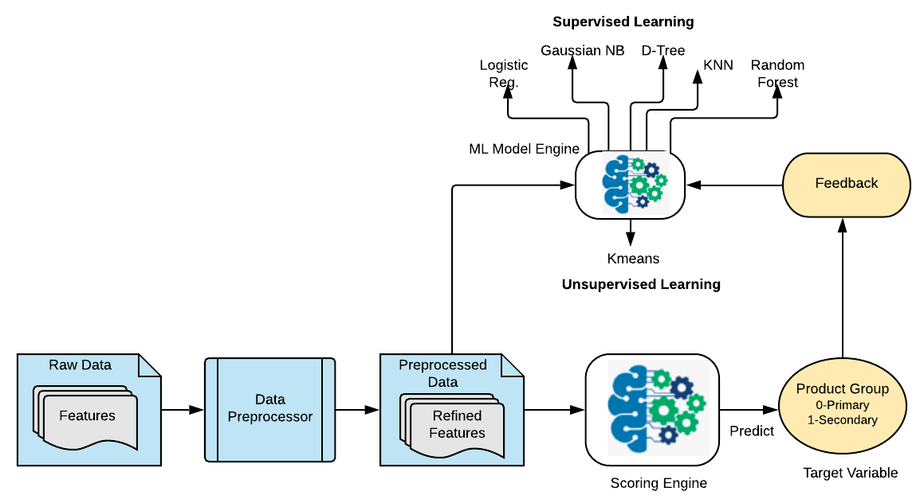
Technical Solution
This is a proposed solution to answer the research question. The solution involves the following steps/components
Ingesting Raw Data (Raw data is in the form of “csv” files)
Building Data Pre-processor for data cleaning, preparation and feature extraction
Building a ML Modeling engine that can consume the pre-processed data and perform training & evaluation
Building a scoring engine that can predict the Product Group for new business requests.
6
2
1

Slide 4
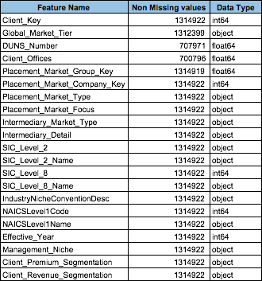
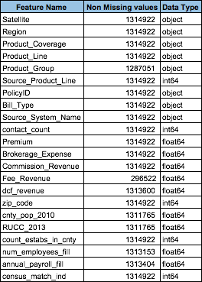
Data Description
Total Observations:
1829898
1314922 (purchase data)
514976 (census data)
Total Predictors:
43
36 - Client Purchase History
9 - Client Census Data
Categorical Predictors:
21
Numerical Predictors:
22
Response Variable:
Product Group
More about the data:
1 overlapping feature (Client Key) between the two datasets
39 Outliers that can be dropped
23 features of less significance
11 features with missing values ranging from 77% to <1%
12 Float, 10 Integer and 21 Char attributes

Slide 5
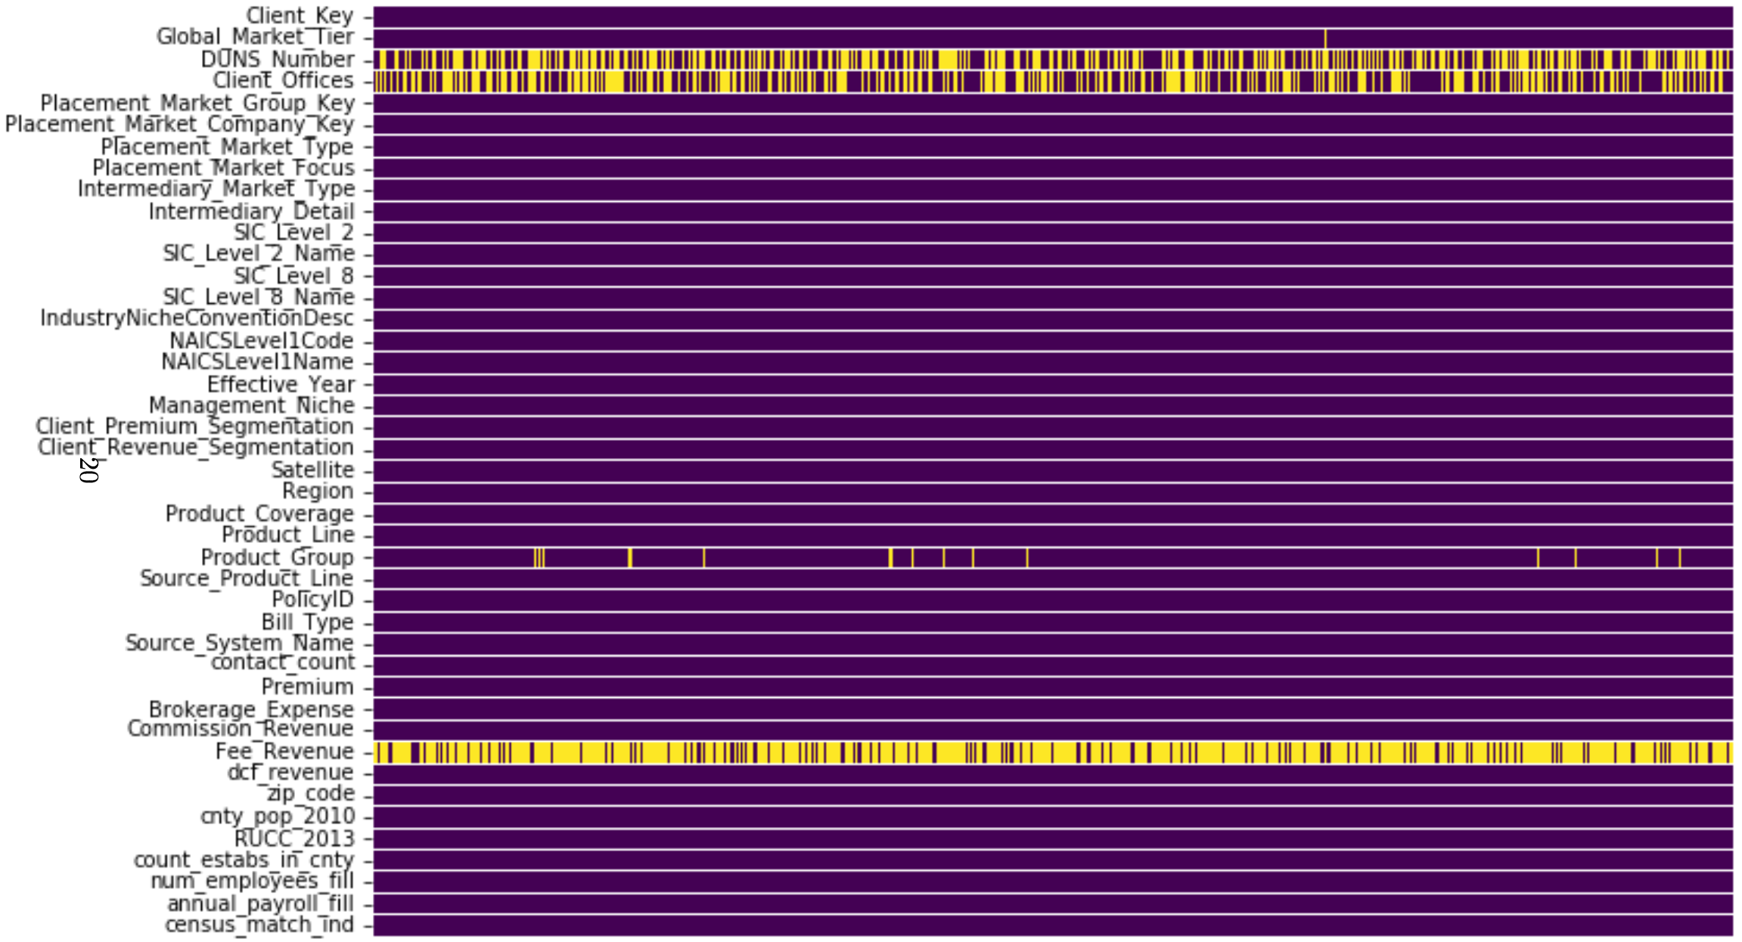
Data Description - Heat Map
6
2
1

Slide 6
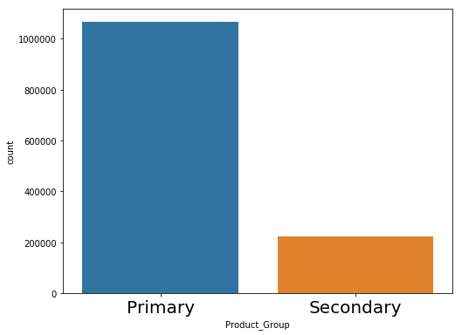
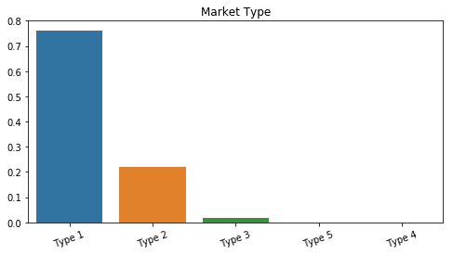
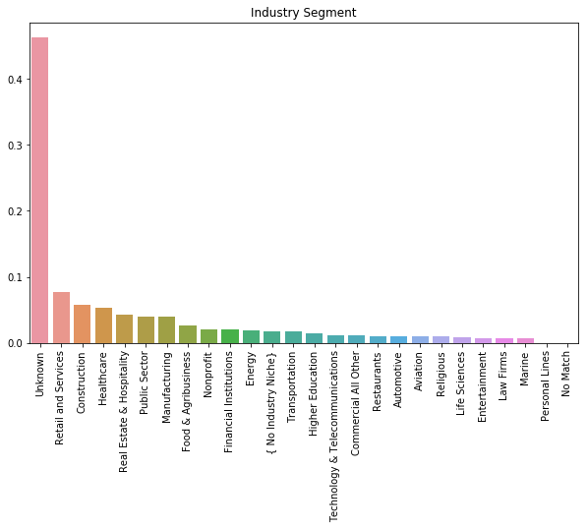
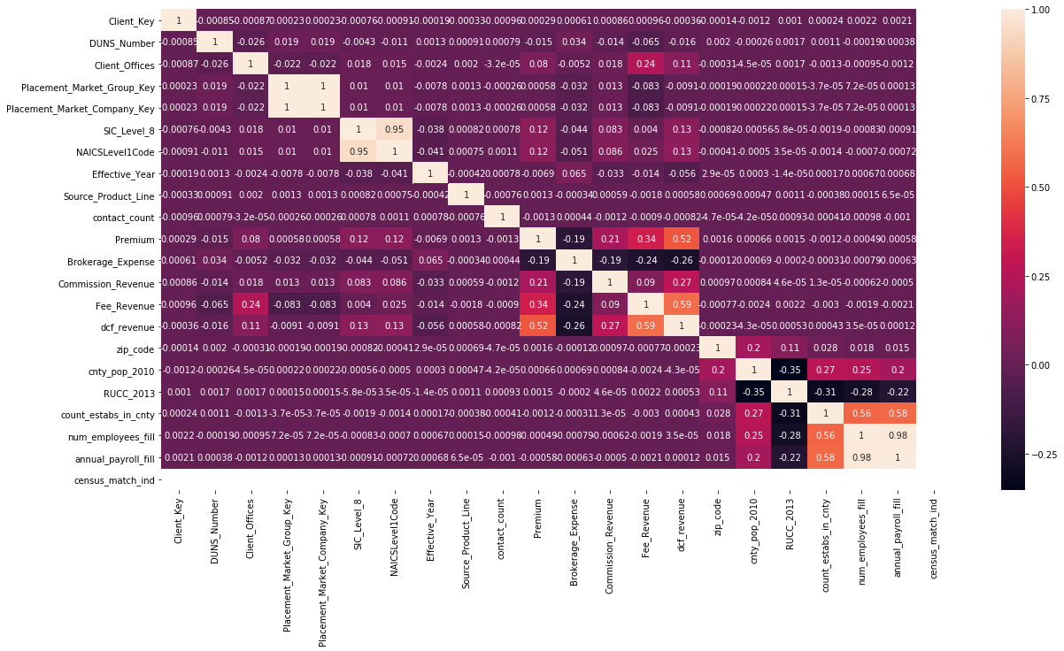
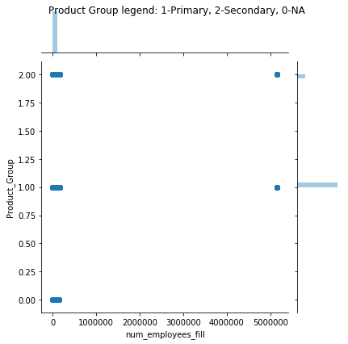
Sample EDA
6
2
1

Slide 7
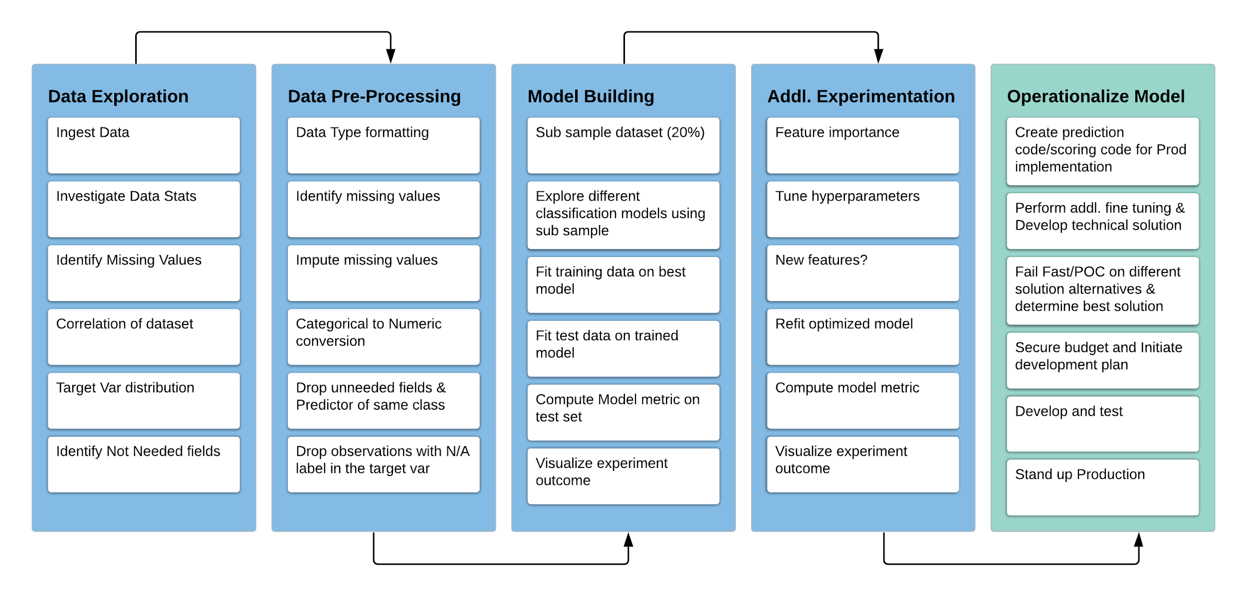
Model Pipeline
6
2
1

Slide 8
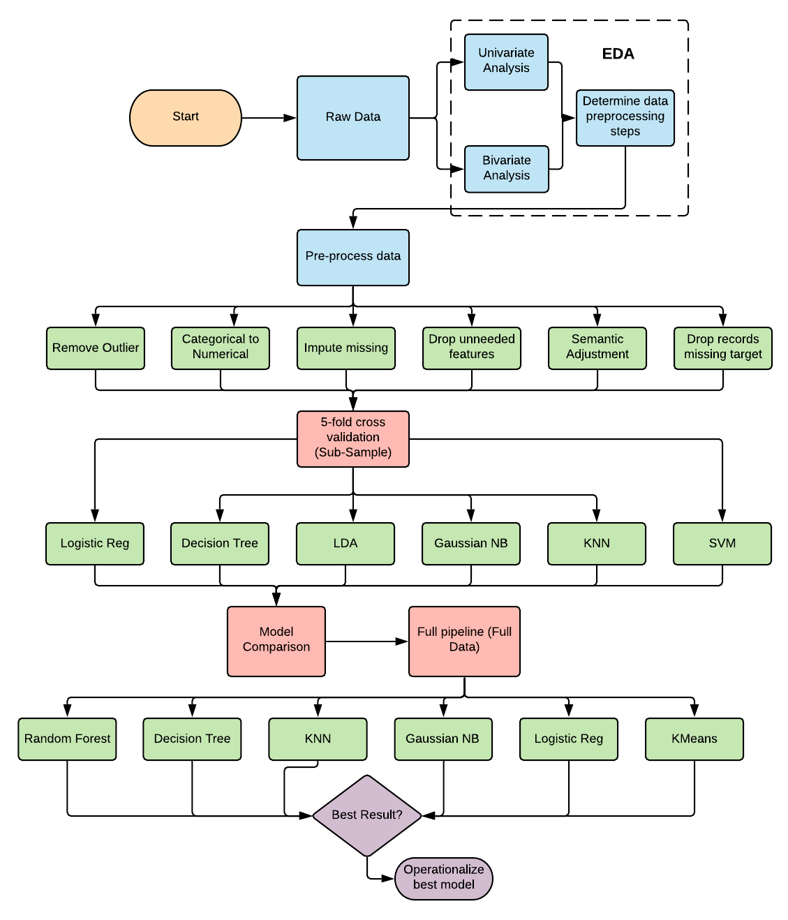
Method - Detailed Approach
Model Comparison
Use preprocessed data and sub-sample 10-20% of the dataset
Split the sub-sampled dataset into train and test using random split
Perform cross fold validation using different Supervised learning algorithms
Visualize and compare the results
Document results
Model Training and Evaluation
Use full preprocessed dataset with optimal set of features
Split the dataset into test (20%) and train (80%)
Train using different Supervised and Unsupervised learning algorithms
Predict test data using different model
Visualize feature importance outputs on different models
Compare and document results

Slide 9
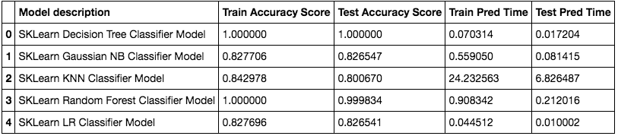

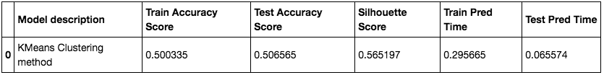
Results
Supervised Learning
Unsupervised Learning
Inference
Preliminary results above indicate Decision Tree is the best and Kmeans is the worst.
From a operationalization perspective Random Forest seems to be the best

Slide 10
Conclusions
Following are some interesting conclusions and inferences from the findings so far.
All of the data pre-processing and feature engineering steps had a significant positive impact on the model training and evaluation.
Model comparison showed interesting perspective on different methods along with the accuracy results.
As discussed in the previous slides, multiple models including supervised and unsupervised learning methods were explored with different parameter setting and cross validation was used to identify the best estimator that produced the best accuracy score.
SVM model performed very poorly and determined not to be an ideal solution for this research.
The KNN classifier although produced a reasonable accuracy will not be an ideal candidate for operationalization because of the concern on performance on larger datasets.
KMeans clustering method produced the lowest accuracy of all the models that were explored and will not be the ideal candidate for Production implementation for this specific research questions.
Tree/Ensemble methods seem to be recommended models for real time implementation.

Slide 11
References
American Institute For Chartered Property Casualty Underwriters (2019). Fundamentals of Underwriting. The Institutes. Retrieved from https://www.theinstitutes.org/doc/resources
Chester, A., Ebert,S., Kauderer,S. and McNeill,C. (2019, Feb). From art to science: The future of underwriting in commercial P&C insurance. Mckinsey & Company. Retrieved from https://www.mckinsey.com/industries/financial-services/our-insights/from-art-to-science-the-future-of-underwriting-in-commercial-p-and-c-insurance
Berger,L., Cummins,D., Danzon,P., Doherty,N., Garven,J., Harrington,S., Klein,R., McDonald,J., Roddis,R., Stewart,B., Stewart,R., (1991). Cycles and Crises in Property/Casualty Insurance: Causes and Implications for Public Policy. Retrieved from https://www.naic.org/documents/. p.1-420. Kansas City, MO:NAIC Publication No. 71
Pedregosa et al. (2011), Scikit-learn: Machine Learning in Python, JMLR 12, pp. 2825-2830 5. Boodhun, Noorhannah & Jayabalan, Manoj. (2018). Risk Prediction in Life Insurance Industry using Supervised Learning Algorithms. Complex & Intelligent Systems. 10.1007/s40747-018-0072-1.
Past Studies
Joly Y, Burton H, Irani Z, Knoppers B, Feze I, Dent T, Pashayan N, Chowdhury S, Foulkes W, Hall A, Hamet P, Kirwan N, Macdonald A, Simard J, Hoyweghen I (2014) Life Insurance: genomicsStratiﬁcation and risk classiﬁcation. Eur J Hum Genet 22:575–579
Fan C, Wang W (2017) A comparison of underwriting decision making between telematics-enabled UBI and traditional auto insurance. Adv Manag Appl Econ 7:17–30
Goleiji L, Tarokh M (2015) Identiﬁcation of inﬂuential features and fraud detection in the Insurance Industry using the data mining techniques (Case study: automobile’s body insurance). Majlesi J Multimed Process 4:1–5
Joudaki H, Rashidian A, Minaei-Bidgoli B, Mahmoodi M, Geraili B, Nasiri M, Arab M (2016) Improving fraud and abuse detection in general physician claims: a data mining study. Int J Health Policy Manag 5:165–172
Nian K, Zhang H, Tayal A, Coleman T, Li Y (2016) Auto insurance fraud detection using unsupervised spectral ranking for anomaly. J Fin Data Sci 2:58–75
Fang K, Jiang Y, Song M (2016) Customer proﬁtability forecasting using Big Data analytics: a case study of the insurance industry. Comput Ind Eng 101:554–564
Cummins J, Smith B, Vance R, Vanderhel J (2013) Risk classiﬁcaition in Life Insurance, 1st edn. Springer, New York

